Slide 4
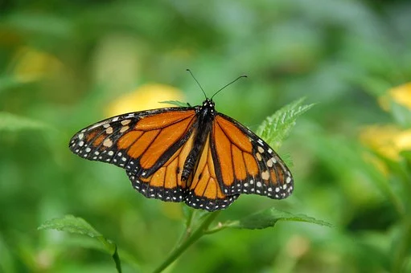
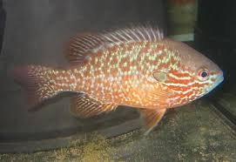
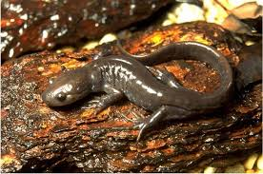
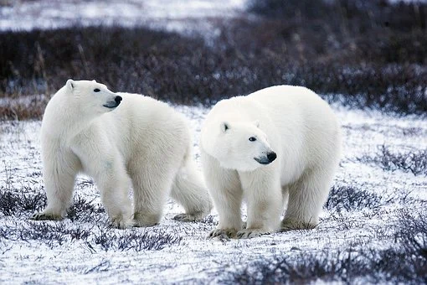
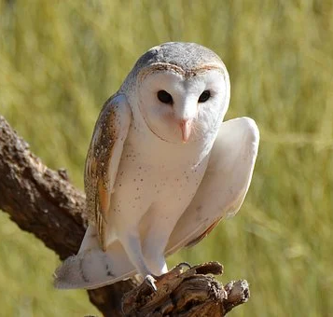
The Monarch Butterfly feeds on milkweed plants.
The Northern Sunfish lives in shallow areas of quiet, slow flowing rivers.
Jefferson Salamanders live in moist soil under logs or in leaf litter.
Polar Bears can be found on the sea ice of the Hudson Bay and James Bay
Barn Owls may use natural holes in trees to nest if it is unable to find a barn or building.

Slide 5
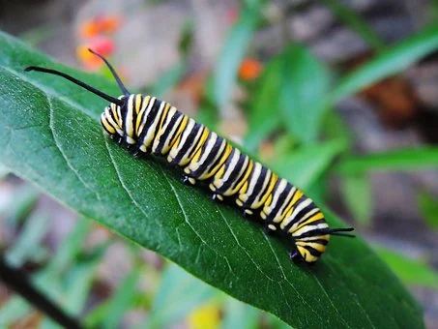
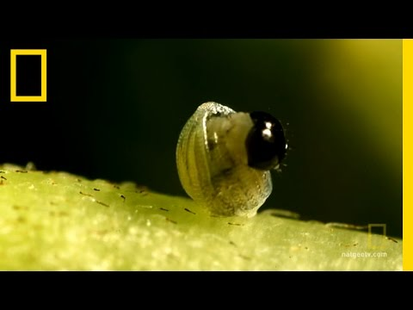
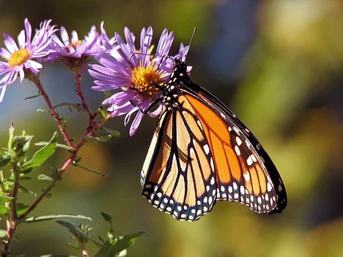
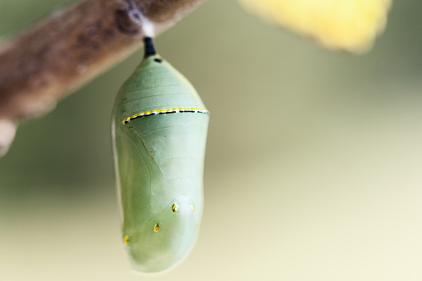
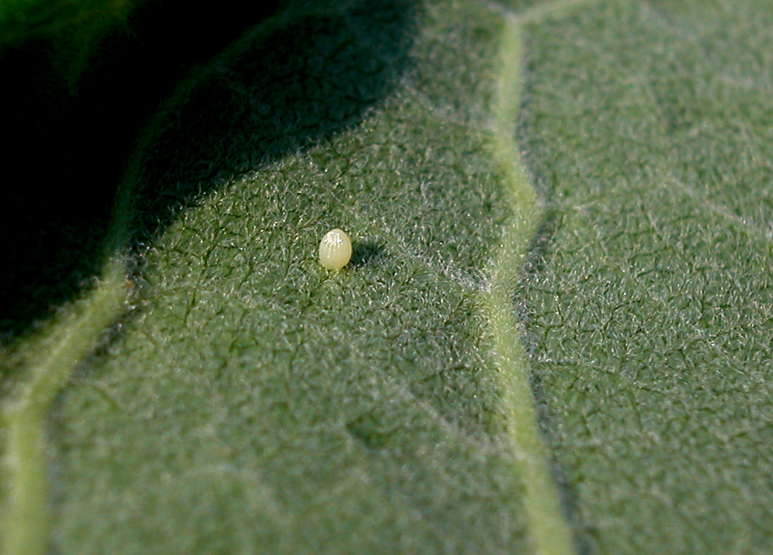

Slide 6
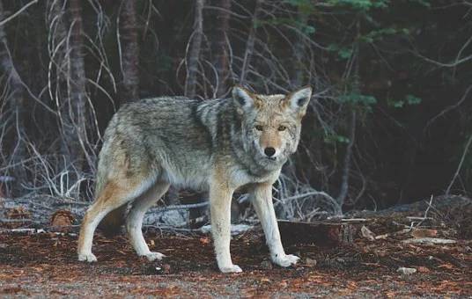
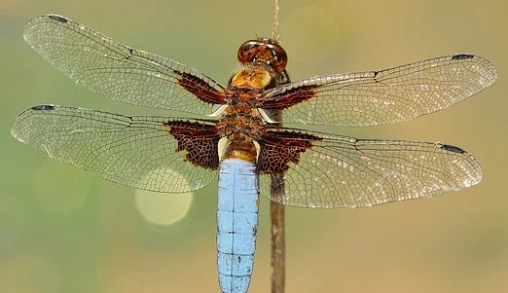
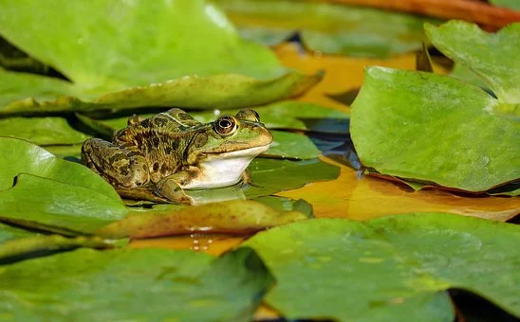
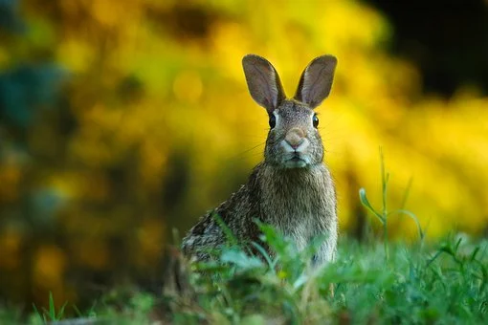

Slide 8
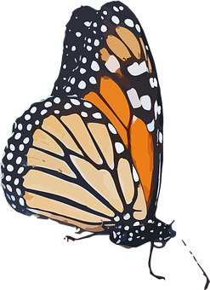
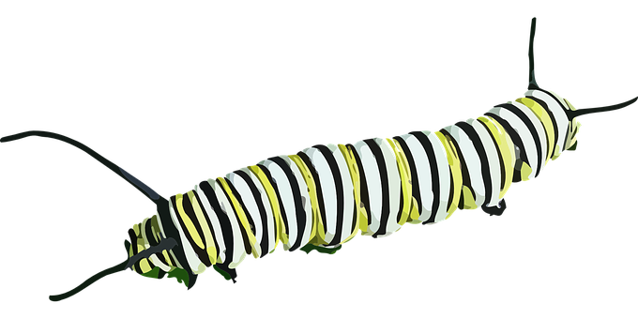

Slide 10
Click and drag the milkweed

Slide 11
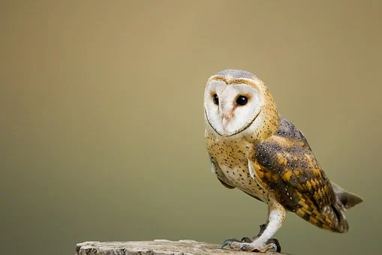
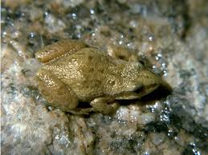
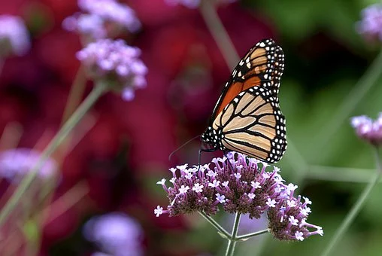
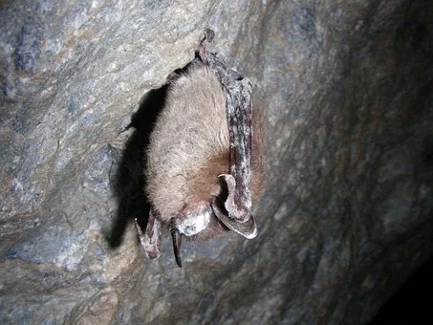
Notes:
As we increase native plants- we increase the biodiversity of insects. Help food sources for Little Brown Bats.
West Chorus Frog- pond habitat- what would be okay to go into the pond. What belongs in the water/ what does not. (remove bad things).
Feed the bat activity
Circle what you think would be the best habitat for a bat! (house #1- one flower, house #2- Trees and 2 flowers, #3, TREE, FLOWERS, BAT BOX).

Slide 12
https://www.ontario.ca/page/species-risk-ontario

Slide 13
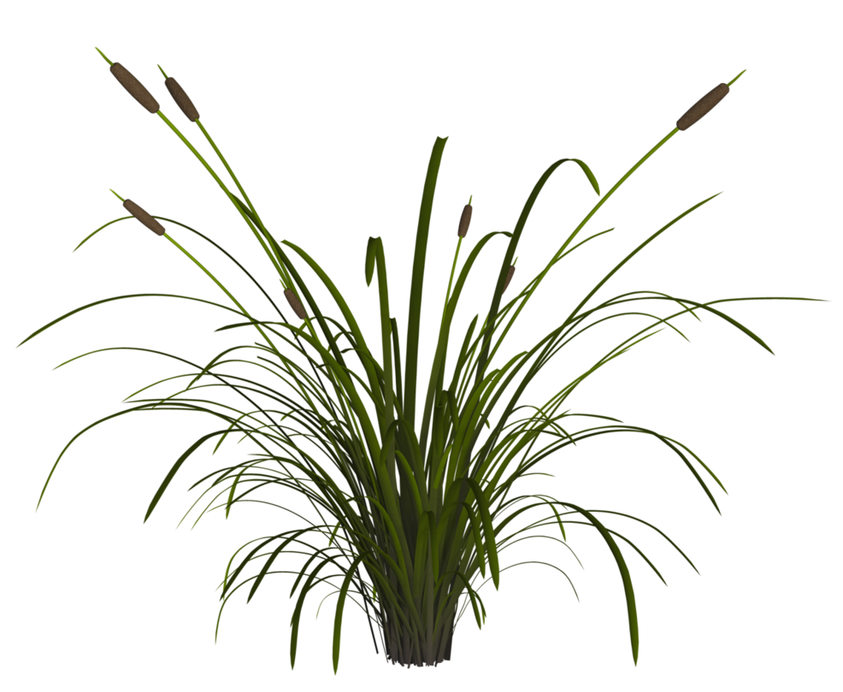
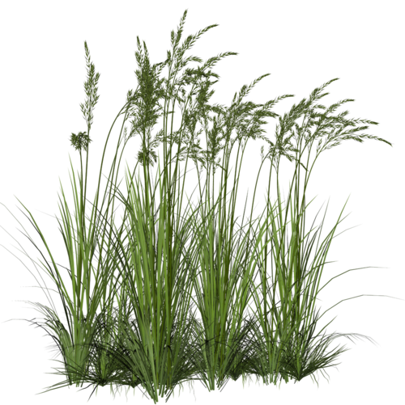
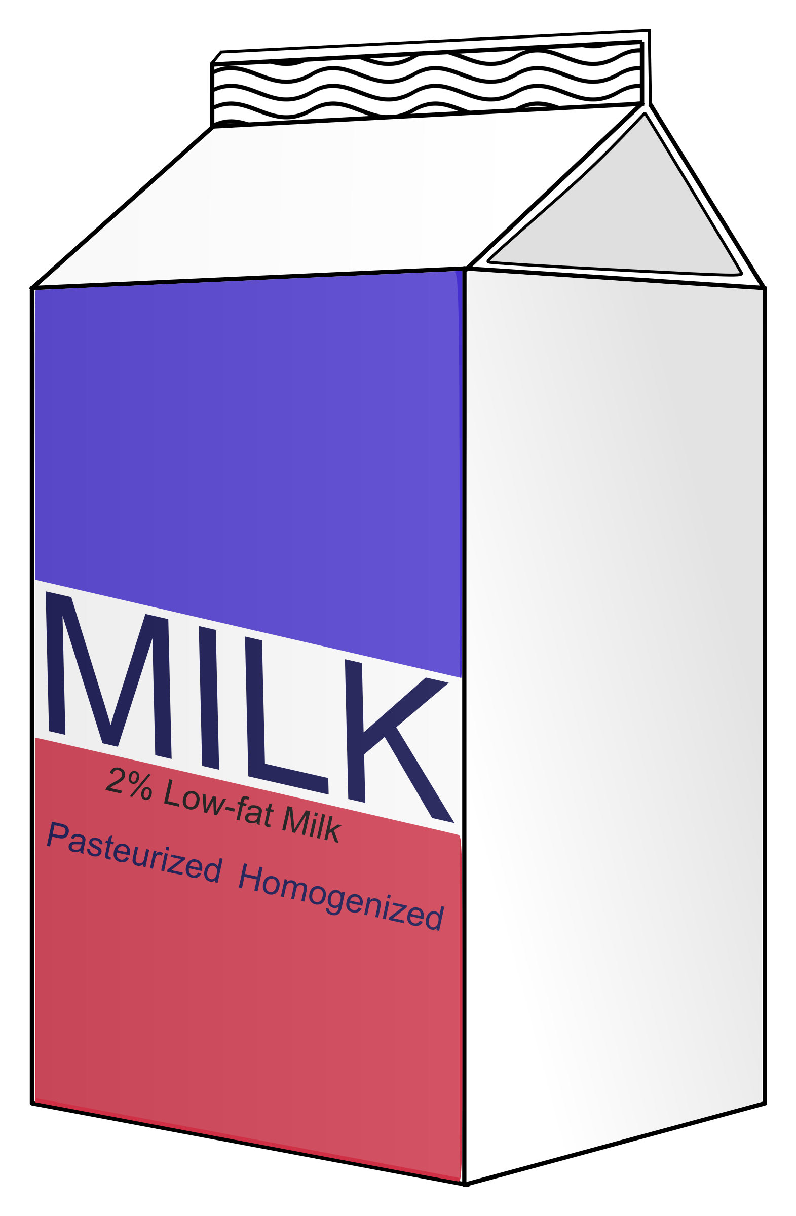
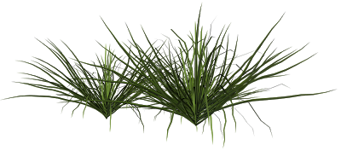

Slide 14
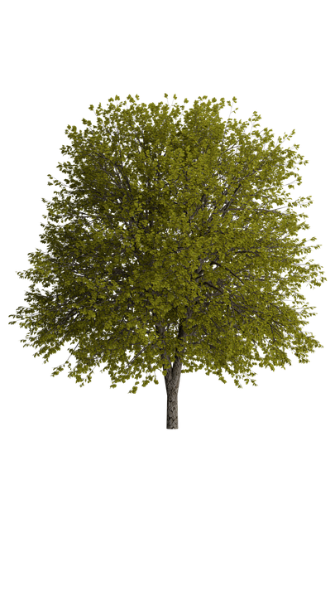
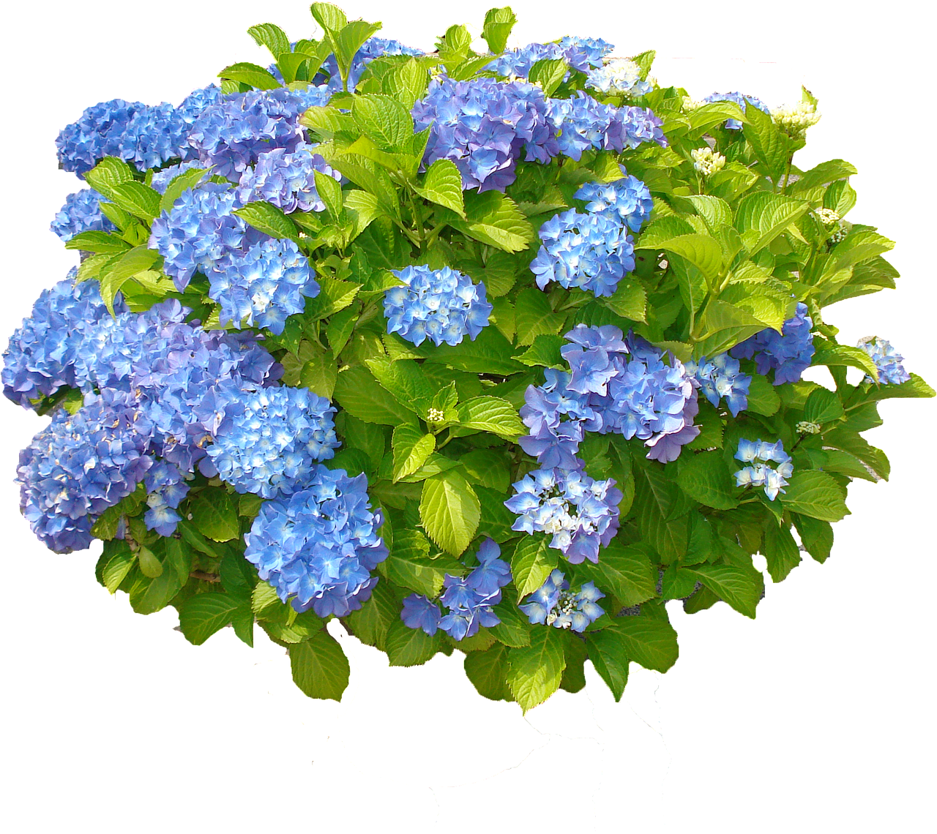
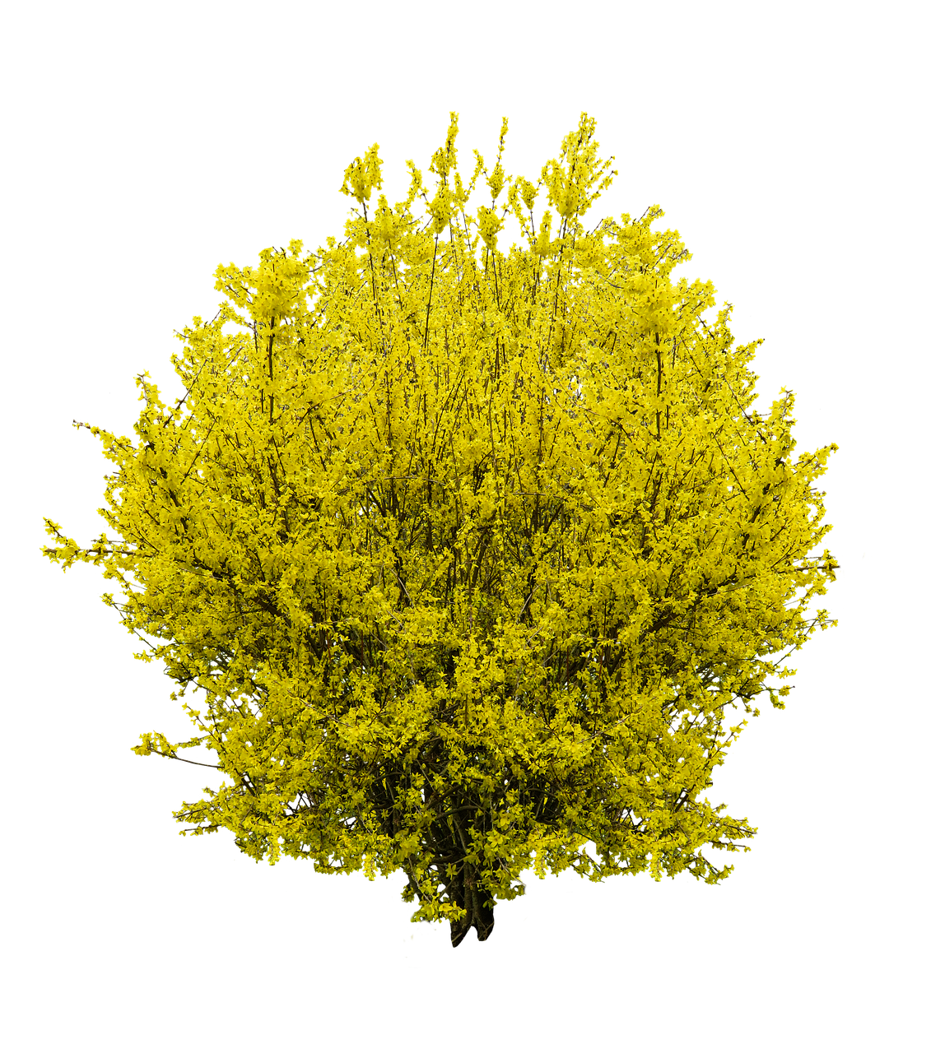
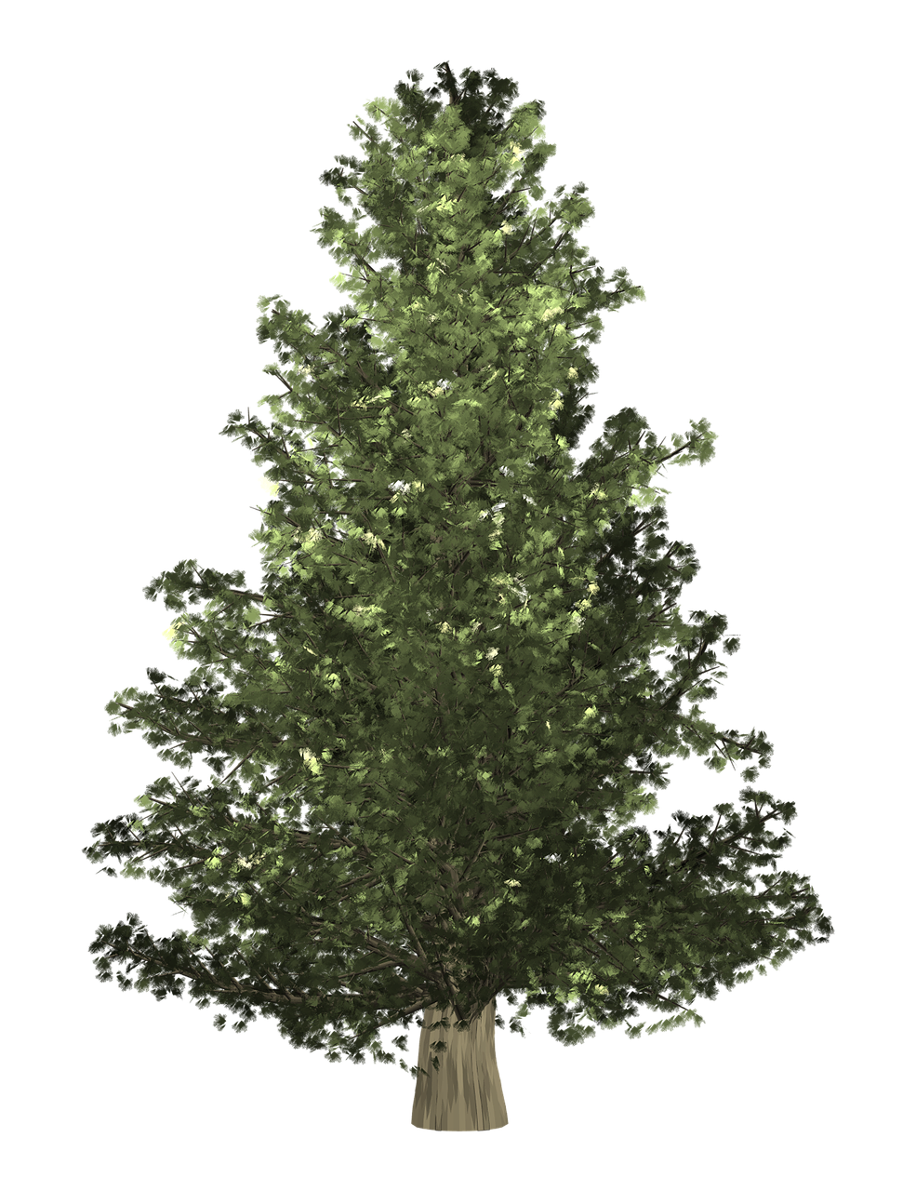

Slide 15
https://www.ontario.ca/page/species-risk-ontario
Insert picture

Slide 16
https://monarchnation.ca/
https://monarchnation.ca/flight-of-the-monarch/

